Slide 1
Image processing: “Cluster Finding”

Slide 2
Contents
Background 3
The Algorithm 4
Major Challenges 5
Further Improvement 8

Slide 3
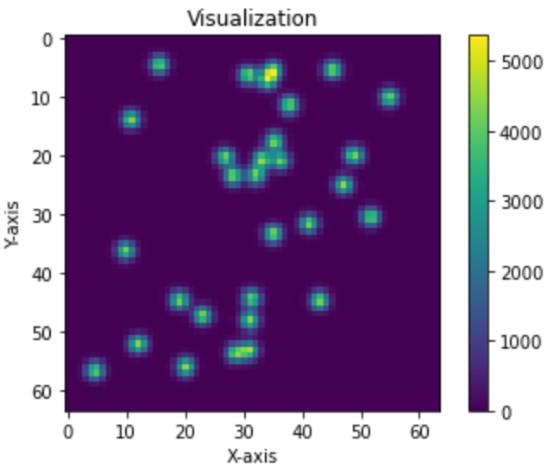
Background
Project 1 focuses on the issue of "cluster finding" in image processing. The main goal of this project is to develop algorithms to identify "clusters" or groups in 2D images. These images can come from various scientific experiments or applications, such as collision data in particle physics, star clusters in astronomical images, etc.

Slide 4
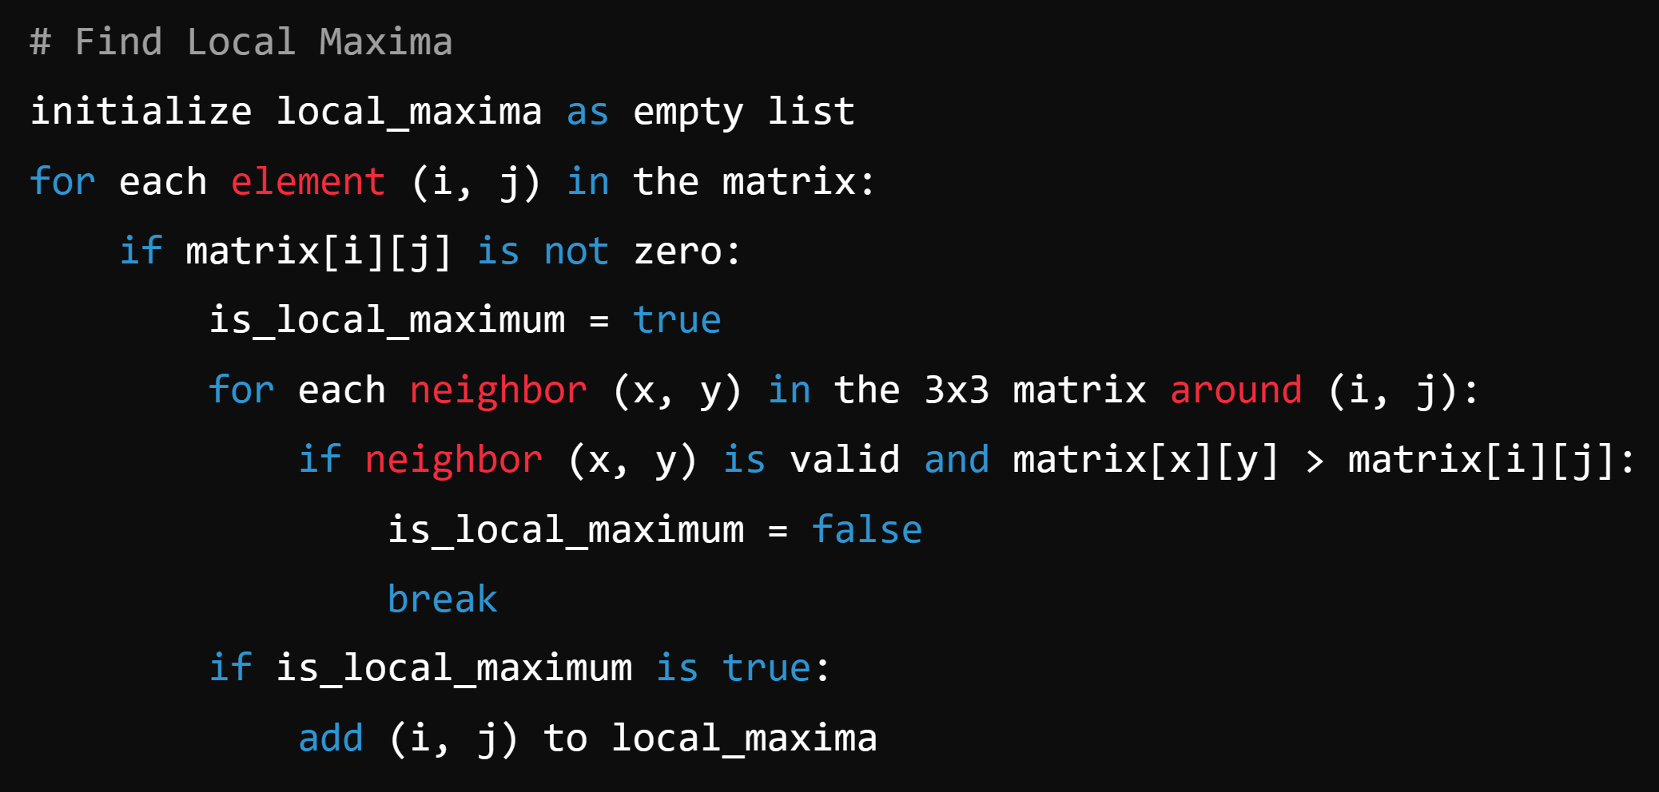
Local Maximum Finding Algorithm: A Simple Approach

Slide 5
Major Challenges
Handling High-Density Clusters
Image Preprocessing and Feature Extraction
Training and Validation of Machine Learning Models
Algorithm Complexity and Performance Optimization

Slide 6
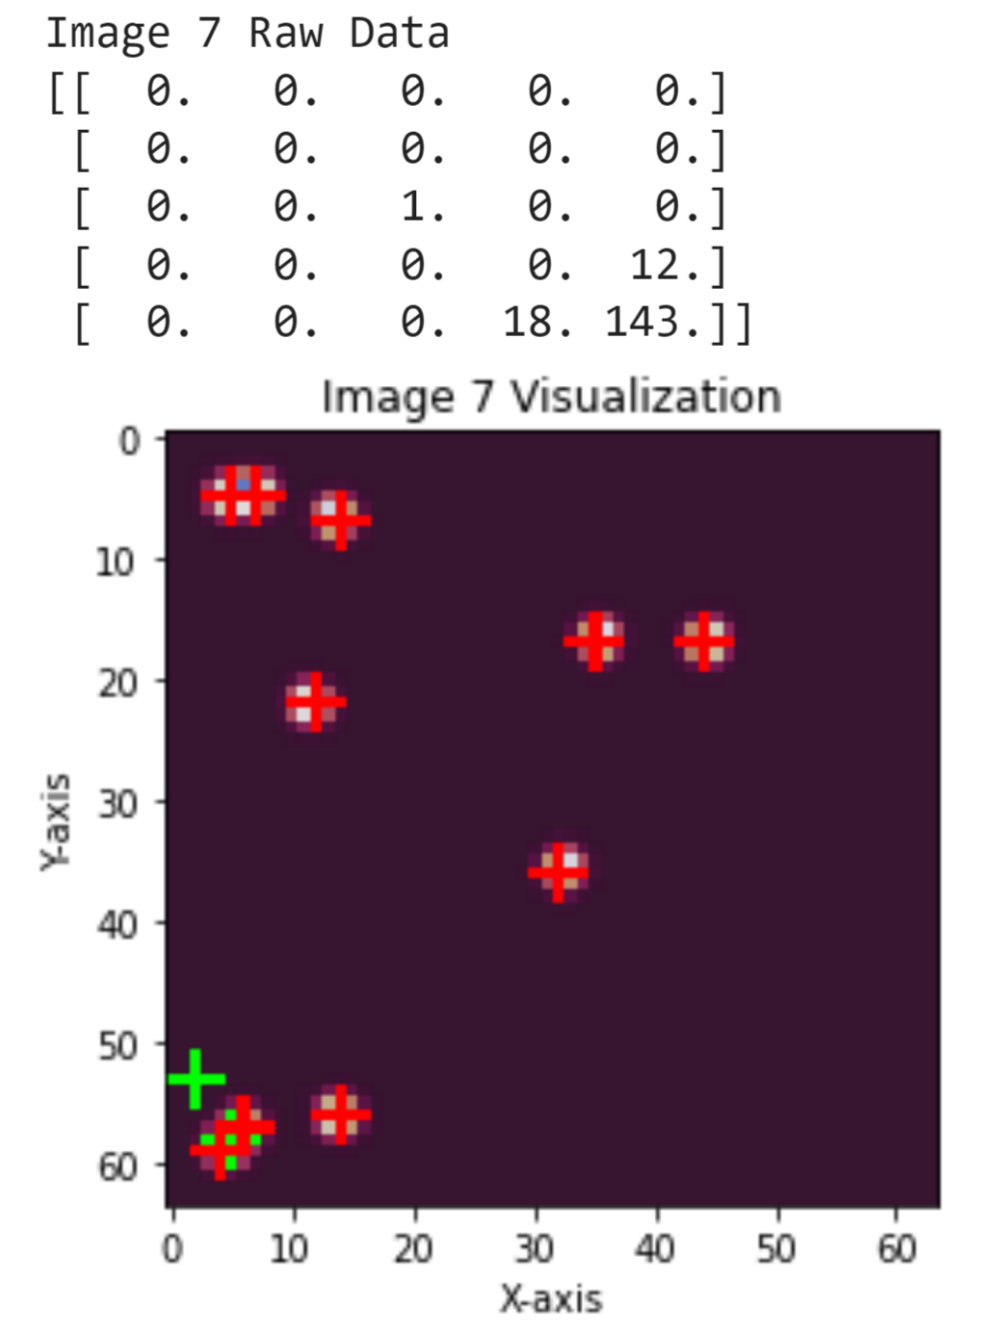
Challenge: Noise
Solutions:
1 Set all the points whose surroundings are zeros to zeros
2 Erosion
3 Thresholding

Slide 7
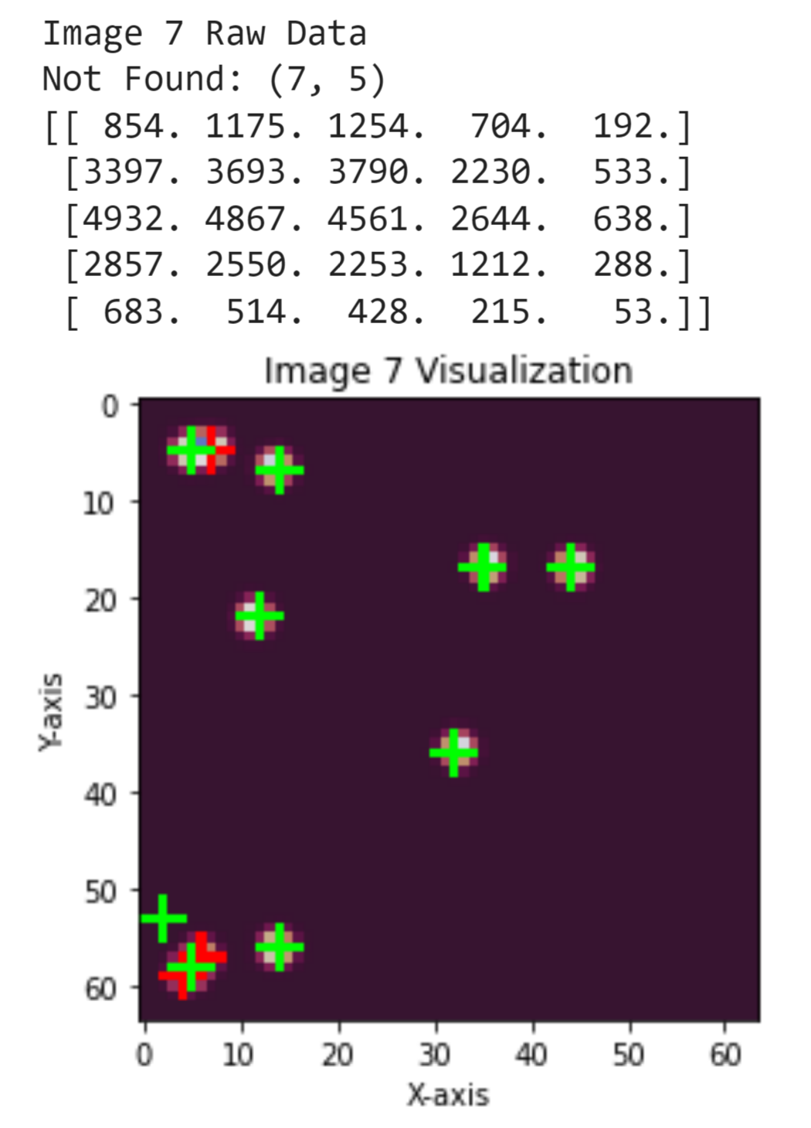
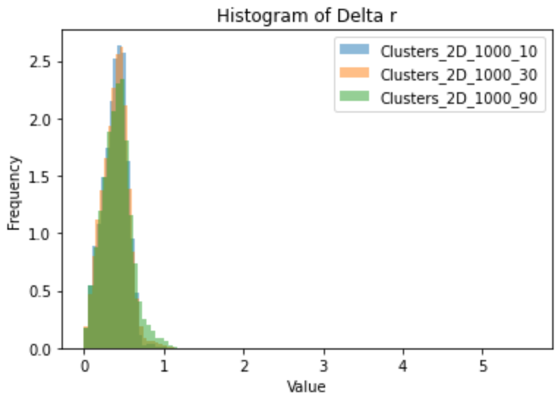
Challenge: High-Density Clusters

Slide 8
Further Improvement
Classify into good/bad clusters
Clusters are classified into good or bad clusters based on the characteristics of the local maximum points of each cluster (such as coordinates, values, the sum of values of the surrounding 3*3 matrix, and the sum of values of the surrounding 5*5 matrix)
Deconvolute bad clusters
For bad clusters (such as two points that are too close to distinguish), deconvolution is used to restore the low-resolution feature map to high resolution for easy differentiation

Slide 9
Thank You for Your Attention

